Slide 1
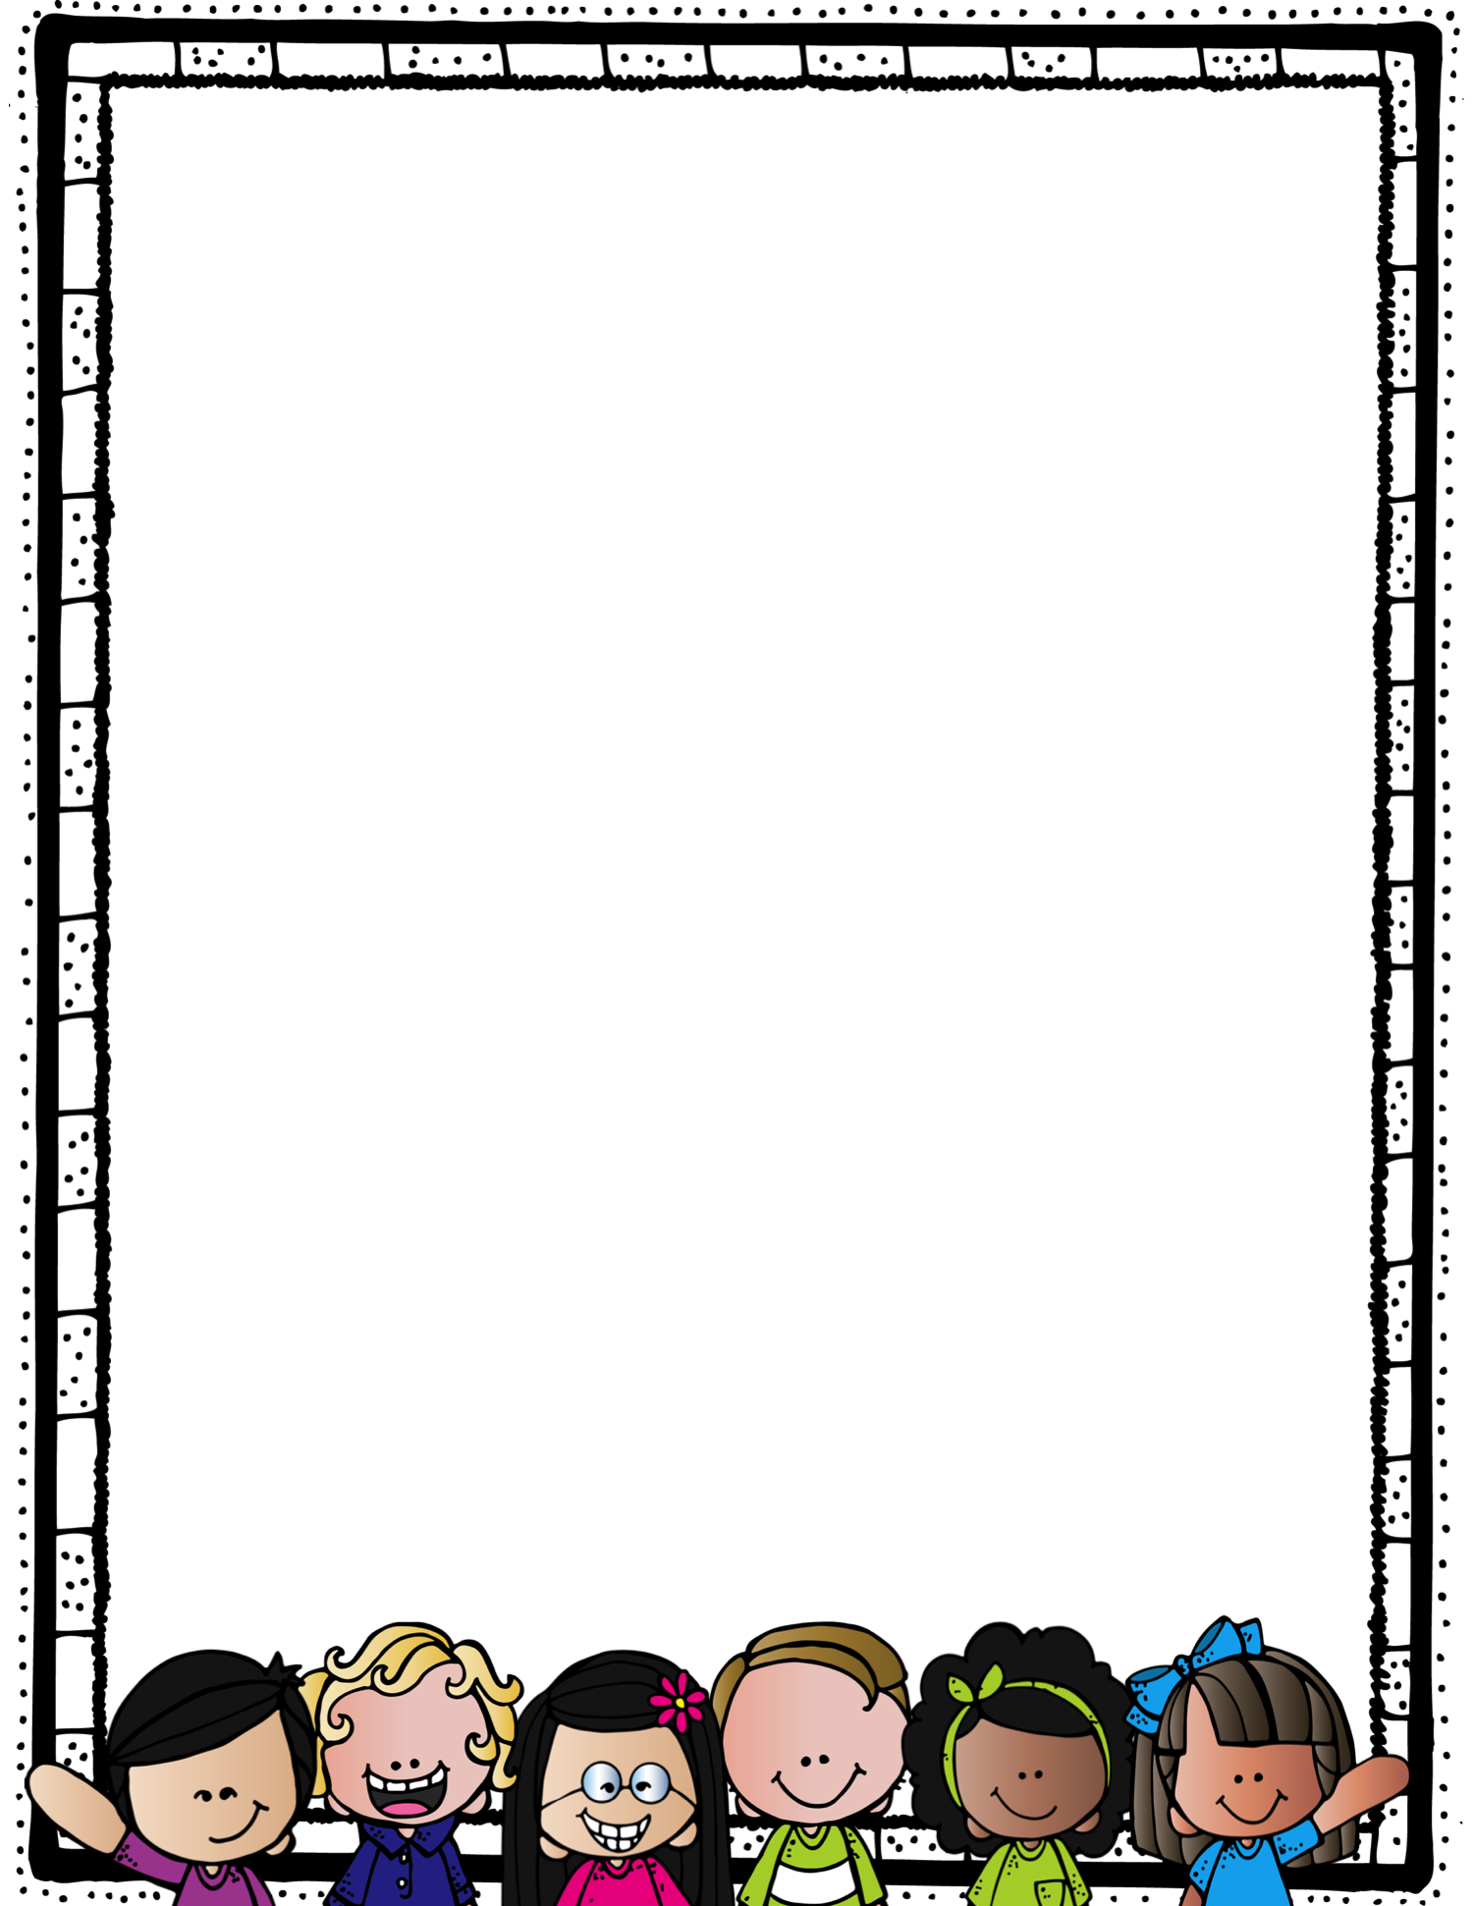
August 2022
Dear Students and Parents,
Welcome back to Lexington Elementary! Hopefully you have enjoyed a wonderful summer and got a chance to unwind, try some new things, or explore a new place. We are excited to start a new year and looking forward to all the things we will learn.
School begins on Monday, August 22nd. We are so excited that the district is providing students with basic supplies this year! If you are able to donate tissues, Clorox wipes, or paper towels for our classroom, we would really appreciate it!
We will be using Class Dojo to post important information about our class and to communicate with families. You will also see messages from our Principal about activities, important dates, and news about Lexington. We will send home instructions to link to our class, as well as a list of student login information for you to keep at home.
We are looking forward to seeing you soon and having an exciting
school year!!
Your Teachers,
Ms. M. Keen and Ms. D. Cole

